Slide 1
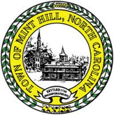
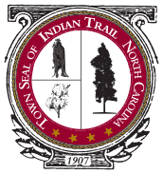
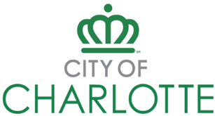
Public works education and career forum
Leadership and Management Division
Hosted by apwa-nc leadership and management division
Presented by nc public works professionals:
Leadership and Management Division

Slide 2
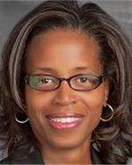
WELCOME
The Public Works Education and Career Forum was envisioned to provide information and understanding to Academic Professionals across the state about public works.
Goal is to support Academic Professionals to inspire and encourage students to pursue public works careers.
APWA Members from the private and public sector have volunteered to provide information, data, commentary, personal experiences and/or to answer questions related to the public works jobs they employ and/or have had.
Theresa Little Watley
City of Charlotte

Slide 3
Agenda
Public Works and APWA Introduction
What is Public Works and Who is APWA
What Does/Can APWA-NC Do
APWA-NC Committees and Scholarships
Creation of APWA-NC Student Chapters
Public Works Professionals Share Their Experiences and Answer Popular Questions
Outcome of Outreach to Students – Mike Macintyre, Magda Holloway
Younger Professionals in Public Works – Allison Wilson
Careers in Public Works – Sherri Jones, Na’imah Humphrey
Recruitment and Retention – Tasha Johnson, Allison Wilson
My Engineering Story…My Way… – Steve Frey
Career Progression and Advancement – Mae Bryant
Private Consulting for Public Works – Michelle Podeszwa
Pride and Purpose of Public Works – Rusty Bost, Russell Byrd
APWA and Public Works – Magda Holloway
Questions for You
Important Links
Contact Information
Theresa Little Watley
City of Charlotte

Slide 4
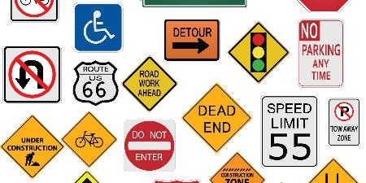
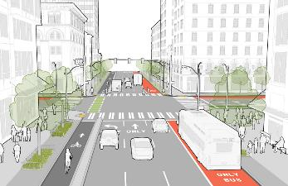
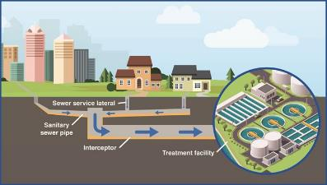
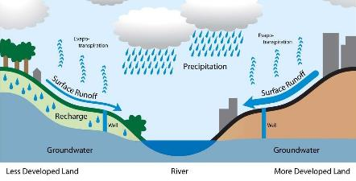
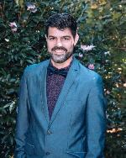
What is public works?
Public works is the combination of physical assets, management practices, policies, and personnel necessary for government to provide and sustain structures and services essential to the welfare and acceptable quality of life for its citizens.
COMMUNITY BASED WORK
Street Signs
Drinking Water
Street Design
Solid Waste
Snow Removal
Road Construction
Wastewater
Stormwater
Adam McLamb
Town of Indian Trail

Slide 5
Who is apwa?
The American Public Works Association (APWA) serves professionals in all aspects of public works.
Provide varied educational and networking opportunities that help public works personnel grow in their professionalism and improve the quality of life in the communities they serve.
Members can be individual, agency, or corporation and can be from varying fields
APWA services members from multiple facets of public work.
Local
County
State
Federal
Private
Adam McLamb
Town of Indian Trail

Slide 6
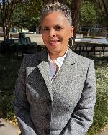
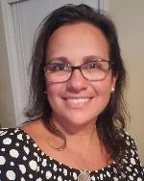
What Does/can apwa do?
Support for Public Works Professionals
APWA supports Public Works Professionals by providing networking opportunities between the public and private sector entities.
Offer new technologies via the APWA partners. These partners/vendors provides demos of equipment and services as resources.
APWA offers training, certifications and training sessions either individually held or through conferences. APWA-NC has the overall State Chapter & 6 technical divisions that offer individual training sessions and/or conferences. The technical divisions are Solid Waste, Facilities & Grounds, Stormwater, Equipment Services & Streets, and Leadership & Management.
APWA also holds the Backhoe Roadeo for lower-level field staff to compete locally and nationally.
APWA offers certification programs through the Donald C. Stone Center. These certifications are in Leadership & Management, Technical Specialties and Public Works Professionals.
Support for College and Pre-College Interest in Public Works
APWA offers scholarships to college students.
APWA offers internships via local municipalities to college students.
Mae Bryant
City of Charlotte
Magda Holloway
Summit Engineering

Slide 7
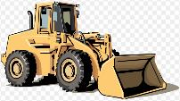
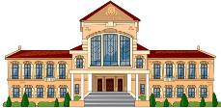
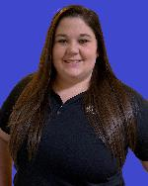
APWA divisions & Committees
DIVISIONS
Equipment Services
Facilities and Grounds
Leadership and Management
Solid Waste
Streets
Stormwater Management
COMMITTEES
Audit
Awards and Scholarships
Diversity
Education and Training
Equipment Rodeo
Historian
Membership
National Public Works Week
Newsletter
PACE Award
Sustainability
Technology
Young Professionals
BENEFITS
Annual Conferences with CEUs
Networking/Socials
Training Events
Educational Sessions
Webinars
Scholarships
Recognition
Resources
Tips and Tricks
Allison Wilson
ESP Associates, Inc.

Slide 8
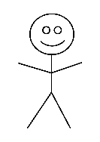
Apwa scholarships
APWA offer multiple scholarship opportunities.
Student Scholarship
$2000 to assist students in attaining their career aspirations and building a foundation of future public works leaders
Internships paying minimum $10 /hr
Scholarship opportunities are posted on the APWA-NC webpage.
Mike Macintyre
Town of Huntersville

Slide 9
APWA-NC Student chapters
Trying to incorporate Student Chapters in NC
Currently engaging with NC State
Outreach with young professionals is VERY important
If interested in getting a student chapter at your high school or college, please reach out.
Magda P. Holloway
Summit Design & Engineering
Notes:
Trying to incorporate Student Chapters in NC
Currently engaging with NC State
Outreach with young professionals is VERY important
If interested in getting a student chapter at your high school or college, please reach out.

Slide 10
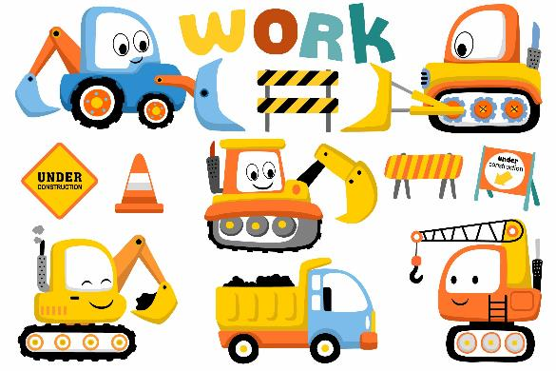
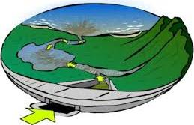
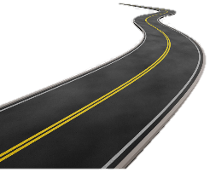
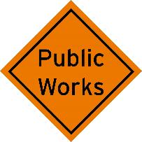
Leadership and Management Division
Public works education and career forum
Public Works Professionals Share their Experiences
and
Answers Popular Public Works Questions

Slide 11
Outcome of outreach to students
Mike’s Story: One day two gentlemen entered one of my classes at UNC-Charlotte and talked about public works and the opportunity for a scholarship. Being a poor student paying my own way, I decided to give the application my best effort. I wrote about my experiences in the Army and a tour of a wastewater treatment plant when I was at a high school leadership conference. One day shortly after the deadline, I received a phone call from someone at the City of Charlotte telling me I had won the scholarship and that I was invited to the Chapter’s annual conference in Atlantic Beach. I went to the conference and met so many awesome people involved in public works, many of whom I still see at various functions and seminars. The scholarship really helped me financially, but attending that first conference changed my life and helped me become interested in working for the various government agencies I have been a part of. Our annual stormwater management conference is one of the most valuable professional development options available to anyone in the industry, and I try to make it to that conference every year.
Magda P. Holloway
Summit Design & Engineering
Mike Macintyre
Town of Huntersville

Slide 12
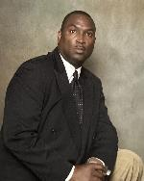
A perspective on the possibilities
Engineer, Air Force Veteran
Work with Universities and Colleges
Share information to make a career work
ENCYCLOPEDIA OF CAREERS
Visit sites with work in your interest
Community college also good for trade careers
Carl Locus
Company
Notes:
Engineer, Air Force Veteran
Work with Universities and Colleges
Share information to make a career work
ENCYCLOPEDIA OF CAREERS
Community college good for trade careers

Slide 13
Younger professionals in public works
PROFESSIONAL
APWA
Public Works?
Anything for anyone
Always hiring new people
$50k-70k
Private Sector Work
Why APWA?
Many Willing Mentors
World of Resources
Innovation in Public Works
Learn the Community
City of Durham (Contracting) – 2 Years
City of Durham (Stormwater) – 2 Years
ESP Associates, Inc – 3 Years
Engineering Degree
Young Professionals Committee
Technology Committee
Leadership and Management Division
Allison Wilson
ESP Associates, Inc.

Slide 14
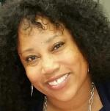
Explore careers in public works – My story
Sherri Jones
City of Charlotte

Slide 15
Types of Public Works Businesses, Departments, and Divisions
Aviation
CATS
Communication & Marketing
Fire Department
Community Relations
Economic Development
Finance
Housing & Neighborhood Services
Human Resources
Innovation & Technology
Internal Audit
Planning
Police and Sheriff
Sanitation
Storm Water
Strategy & Budget
Street Maintenance
Utilities
Sherri Jones
City of Charlotte
15

Slide 16
Over 300 Different Occupations in Public Works to choose from
Administration
Budget
Compliance
Community Service
Engineering
Environment
Executive
Finance
Frontline
Human Resources
IT
Landscaping
Legal
Maintenance/Mechanic
Operations
Planning
Procurement
Public Administration
Communications
Public Safety
Real Estate
Transportation
Sherri Jones
City of Charlotte
16

Slide 17
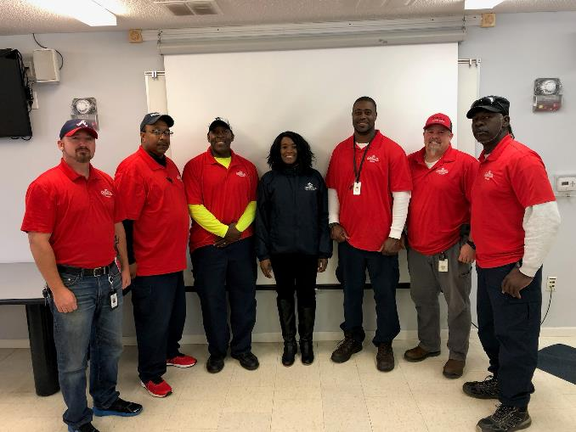
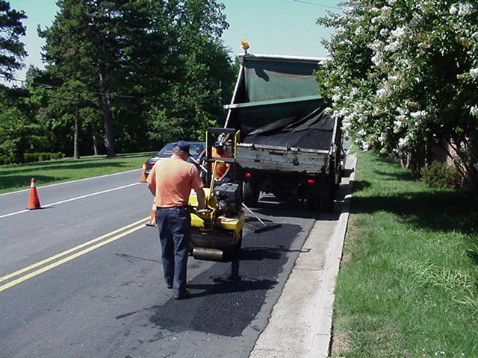
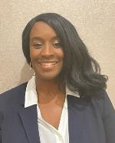
My Public Works story
Na’imah Humphrey
City of Charlotte
Notes:
Introduction and background information

Slide 18
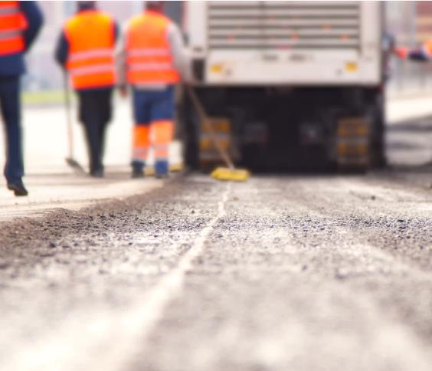
Public works Career Opportunities
Crew Chief
Civil Engineer
Transportation Analyst
Accountant/Finance Manager
Sign Fabricator/Graphic Designer
Construction Supervisor
Water Meter Repair Technician
Utility Technician
Engineering Project Manager
Sign and Marking Technician
Budget/Finance Positions
Crew Member/Laborer
Various Director Level Positions
Various HR Positions
Water Service Technician
Water Meter Repair
Corporate Communications/Marketing
IT and System Analyst
Na’imah Humphrey
City of Charlotte
This Photo by Unknown Author is licensed under CC BY-NC-ND
This Photo by Unknown Author is licensed under CC BY
Notes:
There are endless titles and types of careers available in the public works arena. Some require licenses, certification, and education and some provide the opportunity for employees to development, learn and grow through on the job training and certifications. Here is a snapshot of a few different titles and areas that one can serve in the public works arena:
Water Quality Program Admin
Utilities Operations Manager
Budget and Finance Analyst
Safety Coordinator
Procurement Agent
Treatment Plant Electrician
Project Manager
Customer Service Revenue
Wastewater Treatment Project Manager
Workforce Development Manager
Recruitment Specialist
Budget and Finance Professionals
Marketing
Various types of engineers
For every few people that you see in your city/town doing the front line work (these can be your electricians, sanitation team members, construction crews, surveyors, and engineers, equipment operators, laborers, etc.) there is someone behind the scenes completing the administrative tasks that are associated with that work. Depending on your exposure you might tend to think that work in the public sector is limited to these forward facing careers only. This is far from the truth. Behind the scenes sometimes behind a computer, a device, etc. there is someone planning the work, scheduling the work, inspecting the work, contributing to the work and managing the costs, materials, and people on the backend. All of the work in the public works arena is connected to various people in different capacities with different educational backgrounds, technical knowledge and overall experience.
For positions that involve driving and/or equipment operation a valid CDL (Class A or Class B) is required depending on the equipment size. We are hiring candidates without their CDL however, there are opportunities to get CDL training and your license within a certain time frame and some municipalities will pay for it. Some organizations pay for this upfront or some have reimburse programs for employees who obtain this while employed. Some organizations also now require entry level employees to have a minimum of a high school diploma/GED.

Slide 19
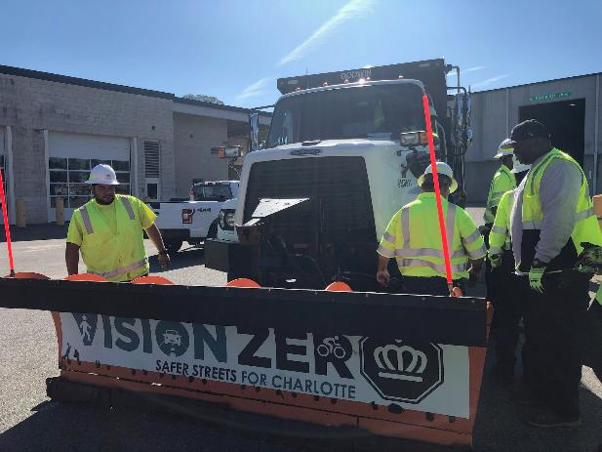
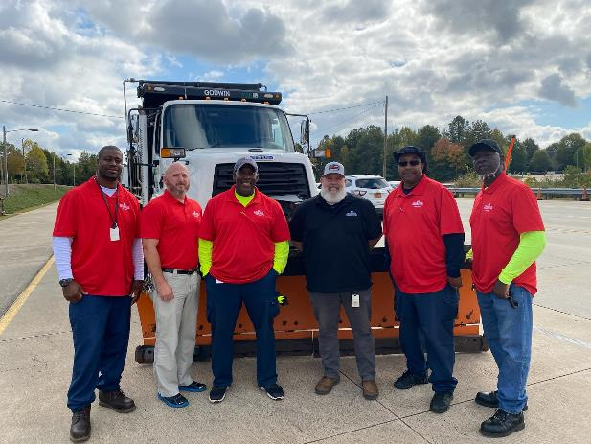
The Work and the People
Na’imah Humphrey
City of Charlotte
Notes:
My story continued
The culture:
Public Works employees work hard to contribute to the work. They like to feel valued and appreciated even if they don’t ever tell you this. Everyone contributes to the work of the team. Every person adds value and has a skill or special technique that they use to get the . A lot of the work can be hands on in nature but hands on can look different based on the role.

Slide 20
Entry Level Preferred Requirements
High School Diploma or GED Equivalent
Valid Driver’s License
CDL Class A or B
Na’imah Humphrey
City of Charlotte
Notes:
Entry level requirements vary depending on the municipality and region of the state/country. For our entry level positions such as a laborer or street crew member
These are preferred requirements
Additional education and experience in concrete construction
$18-$20/hour

Slide 21
Professional and Administrative requirements
Minimum Associates Degree and/or Equivalent Experience
Certifications and Licenses
Each Role is Unique and Has Different Requirement Expectations
Na’imah Humphrey
City of Charlotte
Notes:
Some roles minimum requirements
Other roles may require a combination of both a higher education degree and experience

Slide 22
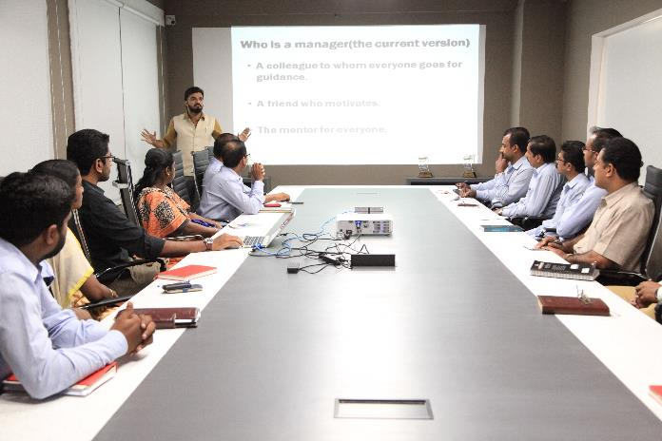
Learning and Personal Development Opportunities
Tuition reimbursement
Opportunities for certification
Learning Management Systems (online training and resources)
Leadership Development
Personal Development
Na’imah Humphrey
City of Charlotte
22
Notes:
Here are some of the professional and personal development opportunities of joining a career in Public Works:
Tuition reimbursement or tuition prepayment programs
Opportunities for certifications and licensure
LMS Learning opportunities (professional, leadership and personal development)
Leadership development opportunities and even mentoring opportunities
Personal development (credit score, housing assistance, finances, health and wellness initiatives)

Slide 23
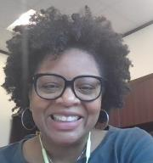
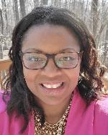
Recruitment: Reshaping/re-branding
Assistant Director – Engineering Division, City of Durham Department of Public Works
20+ (Did you really think that I would write the actual number.)
My journey: Private, NCDOT, AASHTO, City of Durham. I have worked on nearly every stage of roadway project delivery.
Roadway maintenance is my passion. Pursuing equity in project identification, selection, funding, and delivery is my current mission.
The Public Works that you don’t know!
Public Works is more than shovels, dump trucks, pipes, potholes, playgrounds, projects and engineers.
If you are a creative right brain person, if you are a people-person, if you are not a people person, there is a home for you in Public Works. And more importantly, a strong need for you within most organizations!
If you have a passion for the following, you could still be a good fit in Public Works.
Artist Analysts Attorneys
Community engagement Communications Educators
Finance Gamers Graphic Design
Programmers Public Speaking Videography
Writers
Allison Wilson
ESP Associates, Inc.
Tasha Johnson
City of Durham
Notes:
I am Tasha Johnson, currently Assistant Director over the Engineering Division for the Department of Public Works in Durham. I have held this position for over 10 years.
Prior to that I worked at NCDOT (North Carolina Department of Transportation) for about 14 years. There I served in a range of positions but felt my strongest calling toward roadway maintenance and construction. I also spent some time in Washington, D.C. working on transportation policy with AASHTO (American Assocation of State Highway and Transportation Officials).
And lastly, my first job out of college was with a consulting firm designing highways and elevated rails.
So, I have a wide range of experience in the industry.
Fastforward, my current passions are ensuring equity within the community and across all of the projects that we deliver; and engaging and preparing the next generation of engineers and professionals.
To that end, in Durham we have started to rebrand how we promote our department and the engineering profession when recruiting. Public Works is more than just parks, potholes, pipes and projects. We literally build the foundations on which cities grow. We build below ground. On the ground. And above ground. And in addition to building it, we also have to maintain it. The decisions that are made through our work can impact areas, either positively or negatively, for years and generations to come.
Which is why we need people in public works with a wide range of work, education, and lived experience. We need people who can engage with the community and feel a sense of connection to the work that we do. We are not just about budgets, deadlines, and specs. So when you think about careers, know that you can find a home in public works doing a wide variety of tasks that can have significant impacts on lives and communities. There are educators, analysts, artists, policy makers, community activists, writers, designers, and more, in addition what most people think of when asked about public works.
You can take your passion for collaboration, connecting and influencing and apply them here in a real and tangible way.

Slide 24
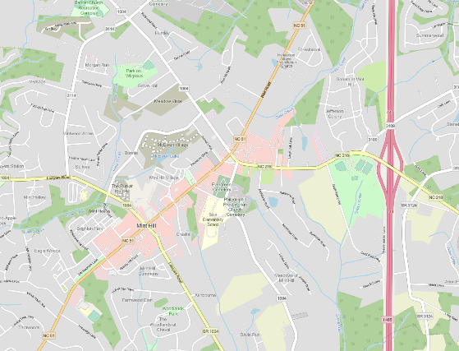
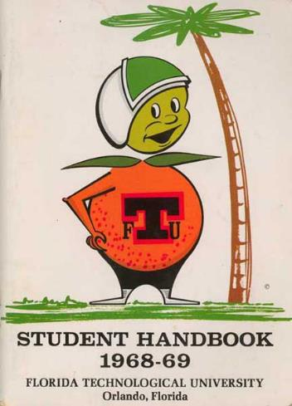
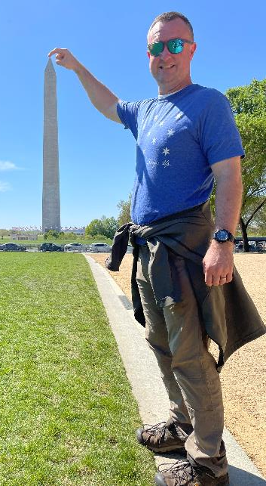
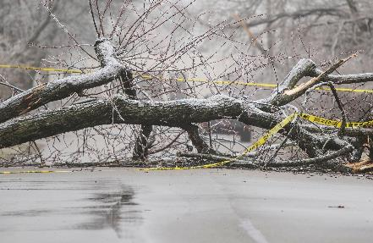
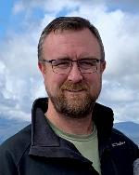
My engineering story…my way…
Steve Frey
Town of Mint Hill

Slide 25
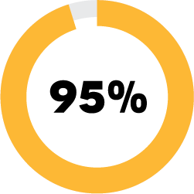
Recruitment
Starting salaries within 90-95% of equivalent private sector jobs
10%
Incentivized starting salaries +5-10%
BONUS
$3,000-$5,000 hiring bonuses
Relocation assistance
Steve Frey
Town of Mint Hill

Slide 26
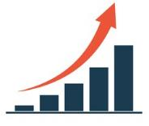
Retention
Longevity bonuses
Pay increases for higher education/training +5-10%
Market rate adjustments
Meaningful recognition
Steve Frey
Town of Mint Hill

Slide 27
Salaries
Average Annual Salary Ranges
Position | S/M Cities | L Cities
Office Professional Staff (Engineering, GIS, PM, etc.) | $45k - $75k | $60k-$100k
Maintenance Workers | $40k - $65k | $45k-$70k
Maintenance Supervisors/Managers | $55k - $75k | $65k - $85k
City Engineer | $90k - $110k | $100-$120k
Director | $100k - $120k | $120k - $150k
Source: NCLM 2022 Salary Data
Steve Frey
Town of Mint Hill

Slide 28
Career progression & advancement
High School Construction Shop Class led to Engineering colleges – NC Agricultural & Technical State University
Didn’t finish but chose a municipal career aligned with my same goals – Mecklenburg County Storm Water Department
Obtained an Associates while working full time – Stormwater inspector to Land Development Inspector
City of Charlotte and APWA and LTAP
APWA Streets Division – Director to President
Continues LTAP classes to maintain certifications and continued networking with APWA which led to advancement opportunities.
Last year re-enrolled in NC Agricultural & Technical State University in a program for students like me
Received a scholarship and graduated with Bachelor of Arts degree in Liberal Studies in December 2022.
Working with public officials and the private sector either through my work or APWA has given me so many opportunities. Leadership, Motivation, and Mentors.
Mae Bryant
City of Charlotte

Slide 29
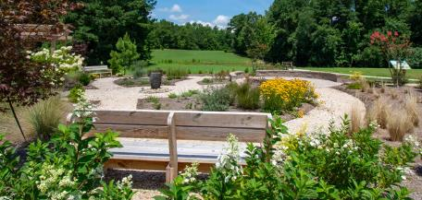
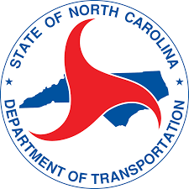
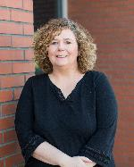
Private consulting for public works
My Story – Michelle Podeszwa
Education / Certifications
Civil Engineering BS from Clemson University
Co-op experience
NC / SC PE
Career path – 26 years in transportation industry
NCDOT – 5 years – Transportation Engineering Associates Program
Private Consulting – 21 years
Private Consulting
Can still focus career on public work
Partners to public entities
Vast opportunities – varying disciplines and projects
Variety of projects, clients, communities
Relationship-based industry
Selection for projects based on qualifications (majority)
Salary range – average $120 K
Job market – industry continues to need talent
Recruitment / hiring / retention
Michelle Podeszwa
McAdams

Slide 30
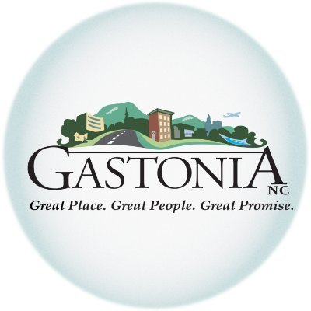
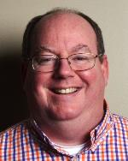
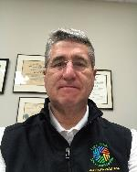
PRIDE AND PURPOSE OF PUBLIC SERVICE
Adam McLamb
Town of Indian Trail
Rusty Bost
City of Gastonia
Russell Byrd
City of Clinton

Slide 31
APWA helped my career in public works
PROFESSIONAL
APWA
Public Works
Started my career 2005
Many networking opportunities have led me to good jobs
Eventually led me to Private Sector Work
Why APWA?
Grew my network to people across the state
Unlimited number of Resources
Currently President Elect for APWA-NC
Keeps me connected with new technologies, private and public sector
City of Sanford – 10 Years
Town of Oak Island – 6 months
City of Charlotte – 2.5 Years
Concentrated Business Management Degree
Town of Wake Forest – 4 years
Summit Design & Engineering
Education & Training Committee – 4 years
Membership Committee -
Leadership and Management Division
Street Division Board Member thru President – 5 years
Magda P. Holloway
Summit Design & Engineering

Slide 32
Important Links
APWA-NC Leadership & Management Division Page
APWA-NC Website
APWA Student Outreach Webpage
Public Works Career Reference Chart
APWA Open Jobs

Slide 33
Questions for you
Google Form to collect some responses from you.
There is a section for any questions you have for us and we will try to respond as they come in.
https://docs.google.com/forms/d/e/1FAIpQLSeaE494xaj8aJRGmI4X8EzzQZIYozYfQYNFGgd1HGcE0XoXbQ/viewform?usp=sf_link

Slide 34
Presenter Contact information
Theresa Little Watley, MSEM, PMP
Leadership and Management Division President
Utility Section Manager
City of Charlotte
(704) 534-0570
Theresa.Watley@charlottenc.gov
Adam McLamb
Leadership and Management Division Vice President
Town of Indian Trail
Public Works Director
(980) 210-5283
ajm@indiantrail.org
Mae Bryant
APWA-NC President
Construction Manager
City of Charlotte
(704) 336-6459
Mae.Bryant@charlottenc.gov
Magda Holloway
APWA-NC President Elect
Project Manager
Summit Design and Engineering Services
Magda.Holloway@summitde.com
Allison Wilson
Technology Committee Chair
Design Engineer
ESP Associates, Inc
(919) 491-7733
Awilson@espassociates.com
Mike Macintyre
Awards and Scholarships Chair
Senior Land Development Plan Reviewer
Town of Huntersville
(704) 766-2220
mmacintyre@huntersville.org
Sherri Jones
Workforce & Career Development Program Manager
City of Charlotte
(980) 312-4486
Sherri.Jones@charlottenc.gov

Slide 35
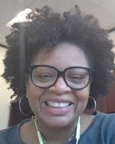
Presenter Contact information
Russell Byrd
City Engineer
City of Clinton
(910) 299-4905 ext. 3091
rbyrd@cityofclintonnc.com
Michelle Podeszwa
LMD President-Elect
McAdams
(980) 221-9002 (office)
(704) 453-1658 (mobile)
Podeszwa@mcadamsco.com
Na’imah Humphrey
HR Compliance and Learning Specialist
City of Charlotte
(980) 221-5128
Naimah.Humphrey@charlottenc.gov
Tasha Johnson
Assistant Director of Public Works - Engineering
City of Durham
(919)560-4326 ext. 30262
Tasha.Johnson@durhamnc.gov
Rusty Bost
Director of Development Services
City of Gastonia
(704) 854-6635
Rusty.Bost@gastonianc.gov
Steve Frey
Town Engineer & Director of Public Works
Town of Mint Hill
704-545-9726
sfrey@admin.minthill.com
Carl Locus
Assistant Director of Facilities Operations, Retired
clocus@same.org

